Slide 1
Tips for Customizing this Presentation
Add information about expectations, time limits, strategies, etc.
Hide or Delete screens that don’t apply
  Choose either the ‘Starting a Test Via Secure Tester’ or ‘Testing without Secure Tester’ section

Slide 2
The Student Experience
Taking an Online Test in Schoolnet with TestNav

Slide 3





How to Take a Test Online
The next few slides will explain these steps:
Sign in
Enter the online test passcode
Answer the questions using the tools provided
Check your answers
Submit your test

Slide 4
Starting a Test Via Secure Tester

Slide 5

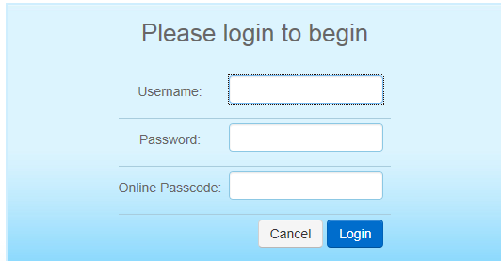
Sign In Through Secure Tester
Launch the Schoolnet Secure Tester icon.
Your teacher or another test proctor will provide you with your username, password, and an online test passcode.
Notes:
Explain that the online test passcode is unique for each test. It is not case-sensitive.
If the computer lab requires a network password, be sure to clarify which password goes where.

Slide 6
Confirm Details and Start
Confirm that the welcome message displays your correct class name and test name.
Click Start Your Test.
On the next screen, confirm that the welcome message displays your name.
Click Start Test Now.

Slide 7
Testing without Secure Tester

Slide 8
Sign in to Schoolnet
Insert info on how students will access Schoolnet (either directly through a portal or through your Schoolnet URL)
*if students sign in directly to Schoolnet and not through a portal used by educators, they may need this extension to access the url and bypass a redirect to your portal. For example:
https://mydistrict.schoolnet.com/Authentication.aspx

Slide 9
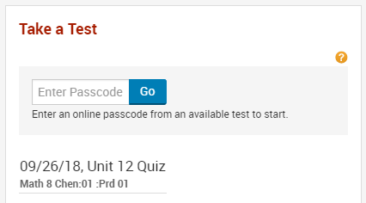
Enter the Online Passcode
In Schoolnet, enter the online test passcode provided by your teacher for the test and click Go.
Notes:
Once you sign in and reach the Schoolnet home page, enter the online passcode provided by your teacher.

Slide 10
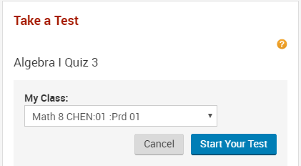
Confirm the correct test and class
Alert your teacher if the wrong class or test name appears. If everything is correct, click Start Your Test.

Slide 11
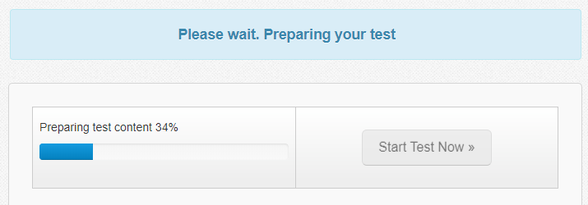
Confirm and Start
It takes just a moment for the test to load. Once the Start Test Now button turns blue, click it to start.

Slide 12
Taking Your Test
Notes:
The following instructions apply to any test taken in TestNav, regardless of whether student uses Secure Tester or not.

Slide 13

Navigate Among Questions
Use the right arrow to move to the next question.
Click Review to jump to any question.

Slide 14
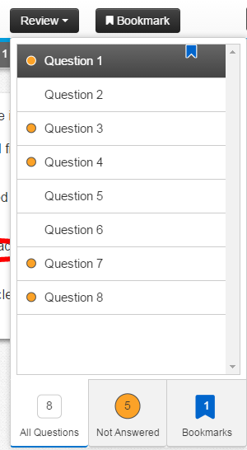
Bookmark Items
If you aren’t sure about your answer choice, bookmark the item to review it later, if you have time.
A blue flag appears in the review menu so you can quickly jump to bookmarked items.
Notes:
.

Slide 15
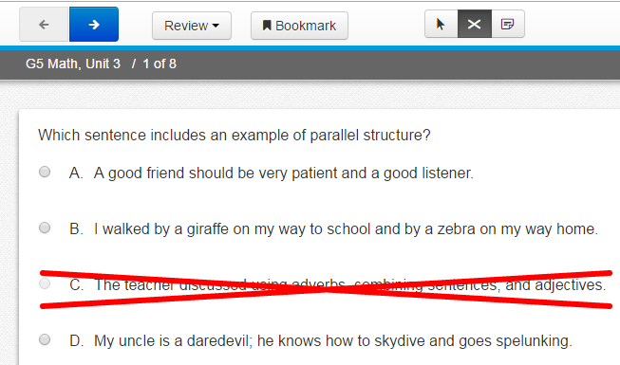
Answer Eliminator
If you aren’t sure of the right answer, but can eliminate some, it may be helpful to cross those out.
Answer Eliminator

Slide 16

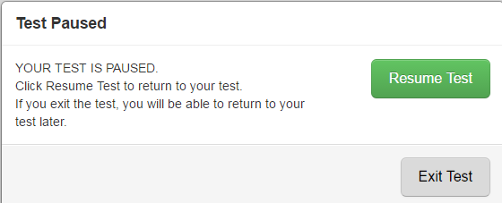
Pausing a Test
Some tests have the option to pause if you have to leave your seat.

Slide 17
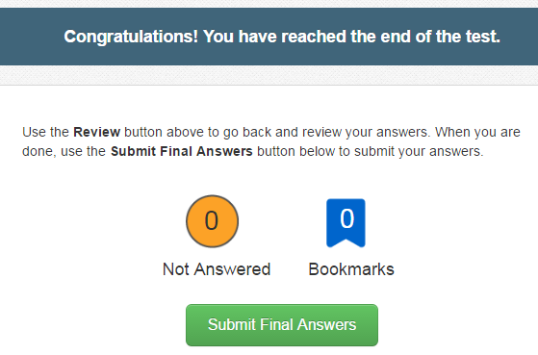
Review and Submit
After you answer the last item, a summary screen provides you the chance to review and unanswered or bookmarked items. Be sure to submit your test.

Slide 18
Features for Math
Notes:
The following instructions apply to any test taken in TestNav, regardless of whether student uses Secure Tester or not.

Slide 19

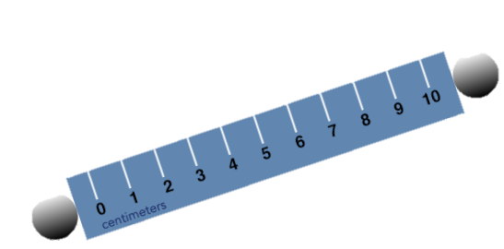
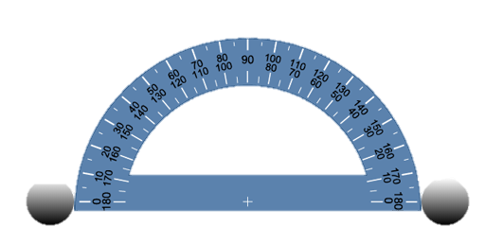
Math Tools
Rulers, protractor or calculators may be available
Notes:
See also: Special Features for Math Quick Reference Card
Drag and drop main part to move, drag and hold gray circle to rotate ruler and protractor

Slide 20
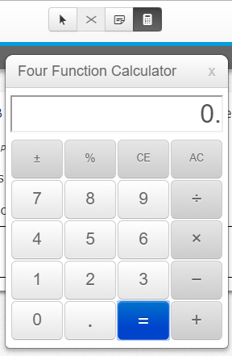
Calculator
Some items may have a calculator available. If you see the icon(s), click to open. You can use your cursor to drag it around the screen.
Notes:
See also: Special Features for Math Quick Reference Card

Slide 21
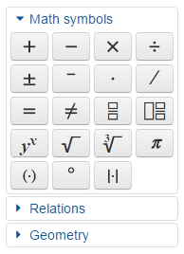
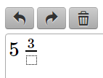
Equation Editor
Some open response items have an equation editor.
Notes:
Place your cursor and then select the appropriate symbol. Squares with dotted lines allow you to enter numbers. Above the text box are icons to undo, redo and delete.
Available symbols may vary.

Slide 22

Gridded Items
With a gridded response item, either click the correct bubble or type in your answer.
Notes:
Sometimes you may see what are called “gridded” items. Either click the numbers in the bubbles or click in the square at the top of the column and type in the value. You may be given more columns than are needed for the correct response.
Note: Depending on the specific item setting, answer may need to be entered with each digit in the column corresponding to its mathematical place. 9if so, this should be communicated to the student in the item prompt.

Slide 23
Other Special Features

Slide 24
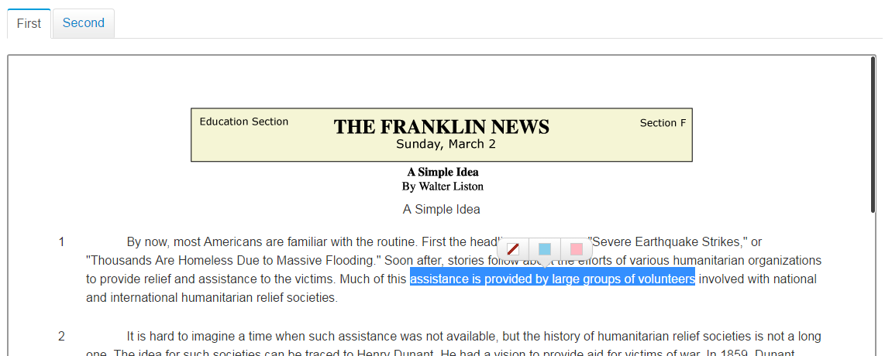
Passages
Use scroll bar to view long passages.
You can highlight key text.
Sometime tests have two passages with tabs to navigate back and forth.

Slide 25

How to Highlight a Passage or Item
To highlight text you think might be important to review as you answer the questions, highlight the text with your cursor and then click the pink or blue square. (Use the other icon to remove highlighting.)

Slide 26
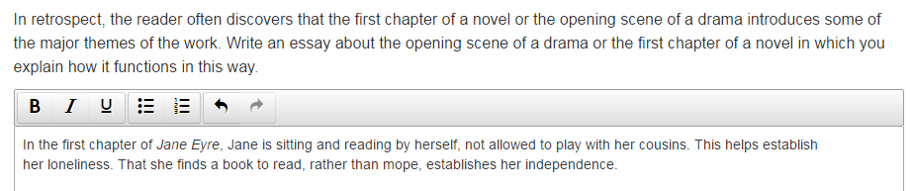
Open Response Items
For some questions, you’ll type an answer in a text field.
A basic formatting toolbar may be available.

Slide 27

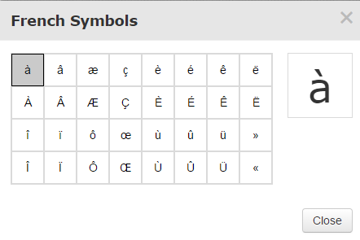
Characters for French and Spanish Open Response Items
For some tests, the formatting toolbar may include a special character button. Click the special character button to open a selection of foreign language characters.
Notes:
The system does not support copying and pasting special characters from a Word document to the test tunnel. Students should use the special character menu to insert accented characters.
See Also: Foreign Language Support Quick Reference Card

Slide 28
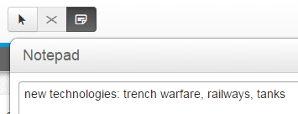
Notepad
Use the notepad to make any notes that will help you to answer the test item. Don’t use this field for your answer.
Notes:
Any text added here will be available to the scorer, but will not show up in item analysis reports.

Slide 29
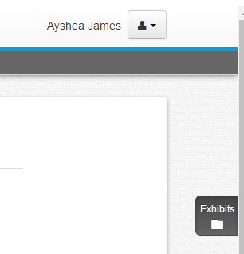
Exhibits
Some items may have a file attachment with support information for you to use. Click the icon to open.
Notes:
The icon appears for any item that has a file attachment for the ‘formula reference sheet.’

Slide 30
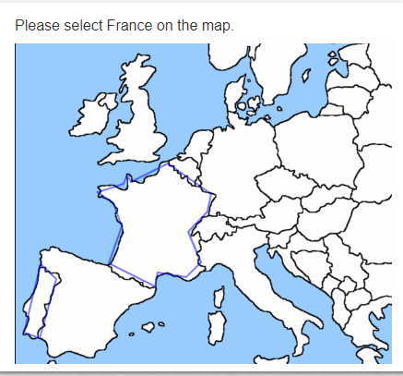
Hotspot Items
On some items, you may be asked to click the correct area or areas on an image.
Notes:
When the student clicks an area, the blue outline will change to a heavy blue outline.

Slide 31
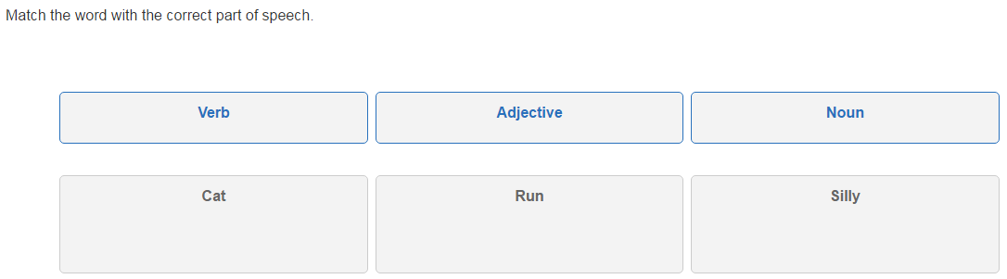
Drag and Drop Items
When instructed to do so, drag answer choices into different containers to indicate your answer.
Notes:
Click and hold down as you drop the answer into the correct container.

Slide 32
Accommodations
Notes:
The following instructions apply to any test taken in TestNav, regardless of whether student uses Secure Tester or not.

Slide 33
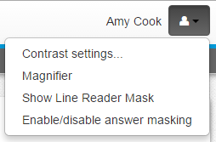
Test Aids
If made available to you, use the options in the menu to turn on and off any available test aids as needed.

Slide 34
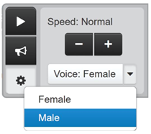
Text to Speech
If made available to you, some tests have a read aloud feature.
Press the Play button to listen.
Click the Gear icon to open settings for speed, volume and gender of speaker.
The Click to Hear (middle) button allows you to select a specific line of text to hear.

Slide 35
Reviewing Your Results

Slide 36
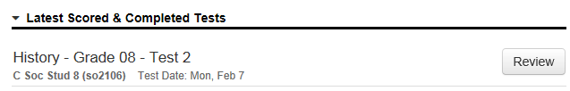
Review Your Results
Depending on the test settings, you may see your results when you submit the test.
Note that points for any open response questions are not yet included; your score is not final until those items are graded.
If item-by-item results are made available to you, access them on the same screen where you entered the online test passcode.
Notes:
Results may also be available after all classes are finished testing. Sometimes you will be able to view the item content along with your answer.

Slide 37
Question and Answer

