Slide 1
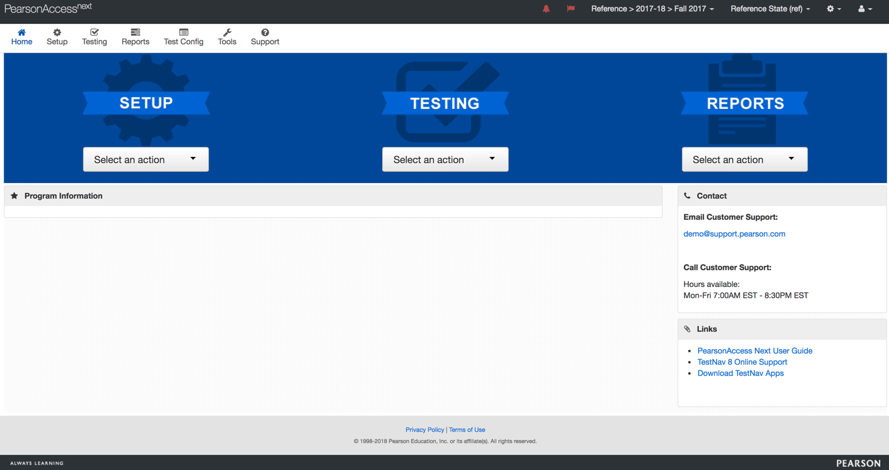


Slide 2
The logo clicks back to the home page.
Depending on your program, you might see this home page with the centered Setup, Testing, and Reports dropdowns; OR navigation dropdowns to the left of the page (shown in later slides)

Slide 3
The Bell icon shows pending Transfer and Reporting Requests.

Slide 4
The Flag icon displays View or Resolve Student Data Errors, Warnings, and Email Delivery Failures.

Slide 5
The Test Administration dropdown changes the selected test administration when you have access to more than one administration. Note that when you sign out and sign back in, the previously selected test administration remains.

Slide 6
You can click the Organization dropdown to change the selected organization when you have access to more than one.

Slide 7
You can click the User dropdown to view and update account details.

Slide 8
If your Home page contains center navigation, click the Setup dropdown to upload and/or create, modify, and track student and test data, as well as order materials.

Slide 9
Click the Testing dropdown to schedule, assign, and monitor test sessions in real time.

Slide 10
Click the Reports dropdown to access student results and operational data through various types of reports.

Slide 11
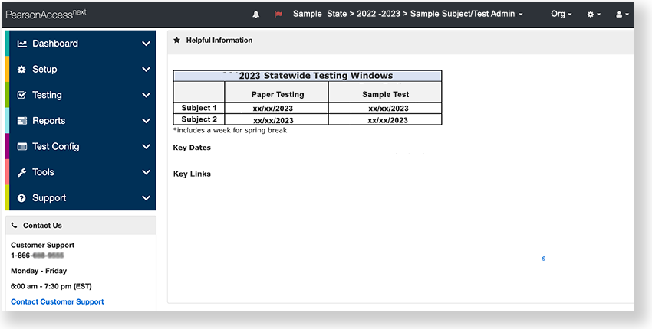
If your Home page contains left navigation, click Setup, Testing, or Reports to access the same options for creating, editing, deleting, and managing data as detailed in previous slides.

